Slide 1

Test Password
Attempting controlled password attacks using Hydra tool

Slide 2
Content
Attempting controlled password attacks using Hydra tool.
Title: Weak Password Testing Using Hydra
Objective: To identify whether the target system allows login using weak passwords.
Tools Used:
Kali Linux
Metasploitable
Hydra
Nmap
Result:
Weak credentials found:
Username: msfadmin
Password: msfadmin

Slide 3
Test Password
Setup Lab:
Kali Linux
Metasploitable
Virtual Box (Set Both Internal Network).

Slide 4
Test Password
Step 1: Install VirtualBox
Install Kali Linux VM
Install Metasploitable VM
Set both to Internal Network
Check with: cd /usr/share/WordList
sudo gunzip rockyou.txt.gz

Slide 5
Test Password
Step 2. Find Target IP:
In Kali: netdiscover
Find Metasploitable IP (example: 192.168.56.101)
Step 3. Scan Target: nmap -sV 192.168.56.101
Look for open service like:
FTP (21)
SSH (22)
Telnet (23)
HTTP (80)

Slide 6
About rockyou.txt
rockyou.txt is a password dictionary file. It Contains about 14+ million real-world passwords
Used for:
  Brute force attacks
  Dictionary attacks
  Weak password testing
It became famous after the RockYou company suffered a data breach in 2009.
Attackers leaked around:
  32 million passwords
  Stored in plain text
Security researchers later compiled them into rockyou.txt.

Slide 7
About rockyou.txt
Where is rockyou.txt in Kali Linux?
If we are using Kali Linux, it is already included.
Location:/usr/share/wordlists/rockyou.txt.gz
It is usually compressed.
How to Extract It
Step 1: Go to directory: cd /usr/share/wordlists/
Step 2: Unzip it: sudo gunzip rockyou.txt.gz
After extraction, you will get: rockyou.txt
Now you can use it in Hydra: hydra -l msfadmin -P /usr/share/wordlists/rockyou.txt ssh://192.168.56.101

Slide 8
About rockyou.txt
What If rockyou.txt Is Not Present?
If you're not using Kali, you can:
Option 1 (Recommended): Install Kali Linux (best for ethical hacking lab)
Option 2: Download from official Kali GitHub repository: Search: kali wordlists github rockyou
(Only download from trusted sources.)
Why Is It Important in Your Practical?
When we run: hydra -l user -P rockyou.txt ssh://targetIP
Hydra: Reads each password from rockyou.txt
Sends login attempts
Stops when correct password is found

Slide 9
Test Password
Step 4: Weak Password Test Using Hydra
Tool: Hydra (comes pre-installed in Kali)
Example: Testing SSH
hydra -l msfadmin -P /usr/share/WordList/rockyou.txt ssh://192.168.56.101
where -l for UserName, -P for Password List, ssh:// for service target IP
If password is weak, hydra will show: [22][ssh]host: 192.168.56.101
login: msfadmin
password: msfadmin
That means you gained access.

Slide 10
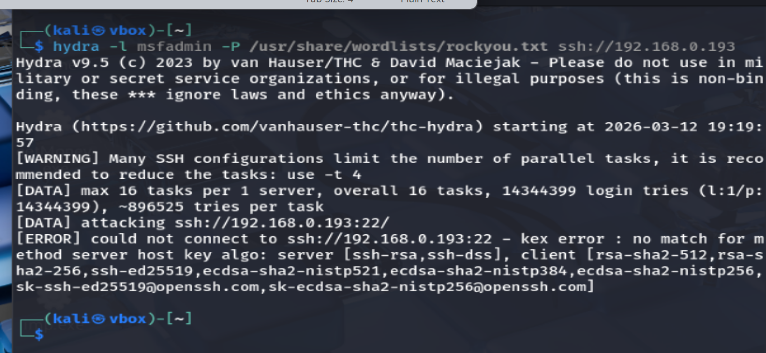
Test Password

Slide 11
Test Password
Step 5: Login Using discovered credentials
ssh msfadmin@192.168.56.101
Enter password.
If successful → you have shell access.
Alternative: Test Web Login (If Port 80 Open)
Open browser: http://192.168.56.101
Try default credentials manually:
admin/admin
admin/password
root/toor

Slide 12
Test Password
For Internet
Attached To: Bridge Adapter/NAT
Adapter 2: Enable Network Adapter
Set it to NAT
Close Internet
Attached to: Host only adapter

Slide 13
Test Password
What is “Gaining Access (Weak Password Test)”?
Testing whether a system allows login using weak passwords like:
admin/admin
root/root
user/123456
test/test
If login succeeds → system is vulnerable.
This falls under Brute Force / Password Attack phase of ethical hacking.

Slide 14
What Happened Technically
Hydra sends login attempts automatically.
Server checks username/password.
If weak → server accepts.
We get unauthorized access.

Slide 15
Test Password
System vulnerable to brute force attack.
Important Ethical Note: Only test: Your own lab
Systems with written permission
Otherwise, it becomes illegal under IT Act.
You can go for:
How to test FTP weak password
How to test Telnet weak password
How to perform dictionary attack step-by-step
How to write professional lab report
How attackers bypass lockout mechanisms

Slide 16
Thankyou

